Slide 1

Dependency Inversion Principle (DIP)
Dr. Siobhán Drohan (sdrohan@wit.ie)
Eamonn de Leastar (edeleastar@wit.ie)
Produced
by:
Department of Computing and Mathematics
http://www.wit.ie/

Slide 2

SOLID Class Design Principles
In this talk, we will refer to the SOLID principles examples in this book.
SOLID → five principles for object-oriented class design i.e.
best guidelines for building a maintainable object-oriented system.

Slide 3
SOLID Class Design Principles
S Single Responsibility Principle (SRP). Classes should have one, and only one, reason to change. Keep your classes small and single-purposed.
O Open-Closed Principle (OCP). Design classes to be open for extension but closed for modification; you should be able to extend a class without modifying it. Minimize the need to make changes to existing classes.
L Liskov Substitution Principle (LSP). Subtypes should be substitutable for their base types. From a client’s perspective, override methods shouldn’t break functionality.
I Interface Segregation Principle (ISP). Clients should not be forced to depend on methods they don’t use. Split a larger interface into a number of smaller interfaces.
D Dependency Inversion Principle (DIP). High-level modules should not depend on low-level modules; both should depend on abstractions. Abstractions should not depend on details; details should depend on abstractions.

Slide 4
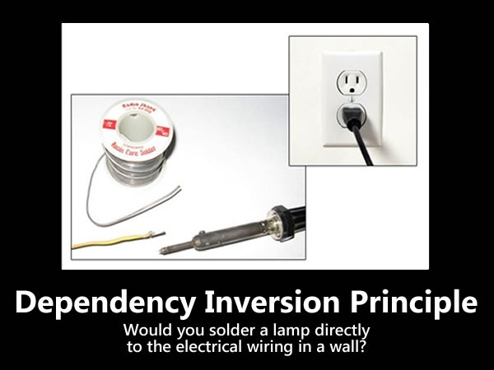
https://zeroturnaround.com/rebellabs/object-oriented-design-principles-and-the-5-ways-of-creating-solid-applications/

Slide 5
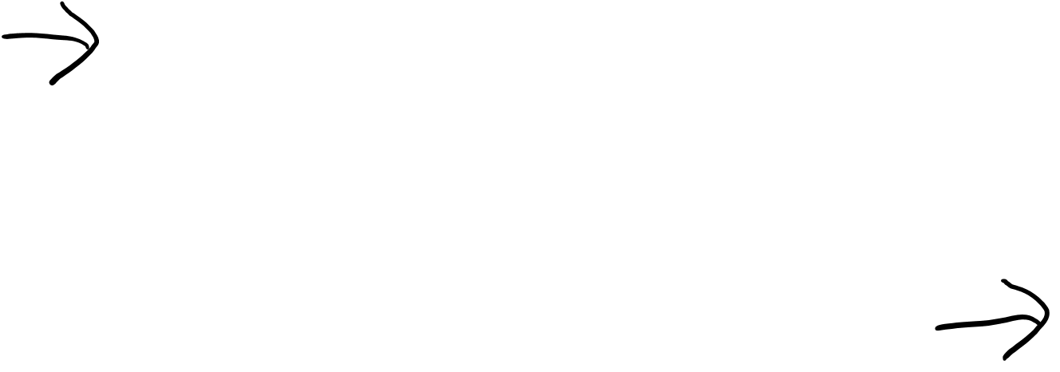
Dependency Inversion Principle (DIP) – Basic Idea
Consider a (bad!) situation where a high-level module depends on a low-level module.
High-level Module
Contains the important policy decisions and business models of
an application.
depends on
Low-level Module
High-level module depends on this module.

Slide 6
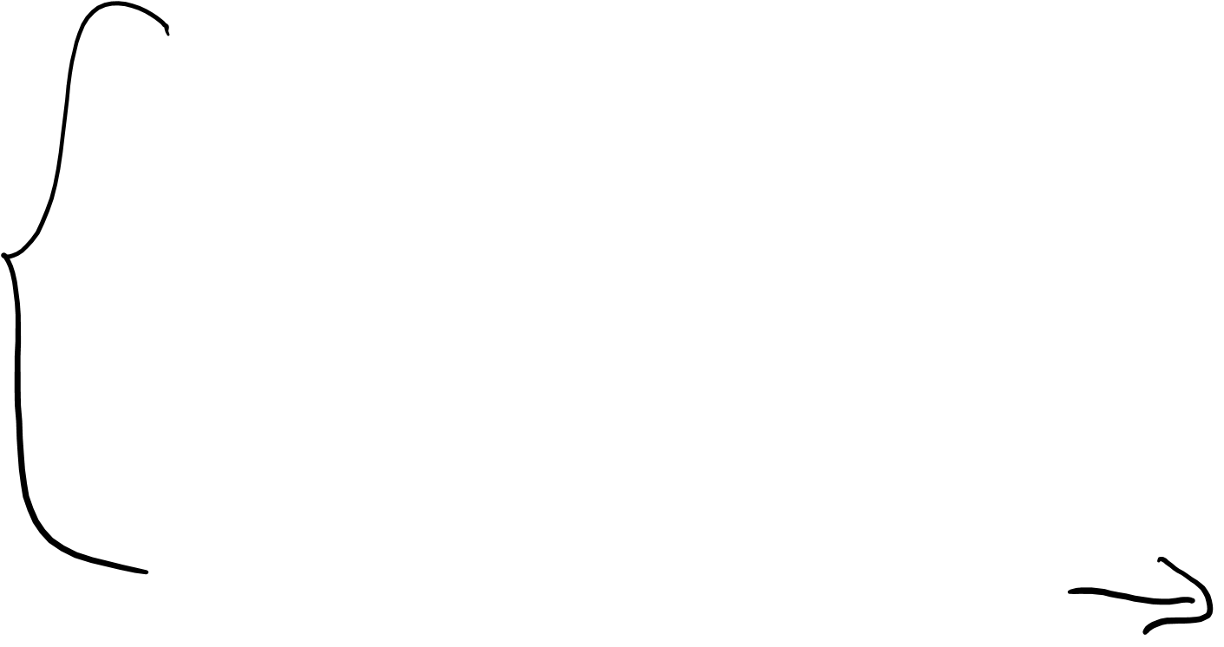
Dependency Inversion Principle (DIP) – Basic Idea
Consider a (bad!) situation where a high-level module depends on a low-level module.
Changes to the lower-level module could directly effect the higher-level module and force it to change.
High-level Module
Contains the important policy decisions and business models of
an application.
depends on
Low-level Module
High-level module depends on this module.

Slide 7
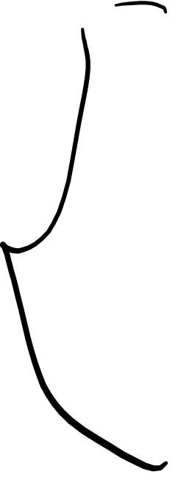
Dependency Inversion Principle (DIP) – Basic Idea
Consider a (bad!) situation where a high-level module depends on a low-level module.
Changes to the lower-level module could directly effect the higher-level module and force it to change.
Absurd!
High-level Module
Contains the important policy decisions and business models of
an application.
depends on
Low-level Module
High-level module depends on this module.

Slide 8

Dependency Inversion Principle (DIP) – Basic Idea
Consider a (bad!) situation where a high-level module depends on a low-level module.
It is the high-level, policy-setting modules that ought to be influencing the low-level detailed modules.
The modules that contain the high-level business rules should take precedence over, and be independent of, the modules that contain the implementation details.
High-level modules simply should not depend on low-level modules in any way.

Slide 9
Dependency Inversion Principle (DIP) – Basic Idea
And taking this idea one step further…
High-level modules simply should not depend on low-level modules in any way.

Slide 10
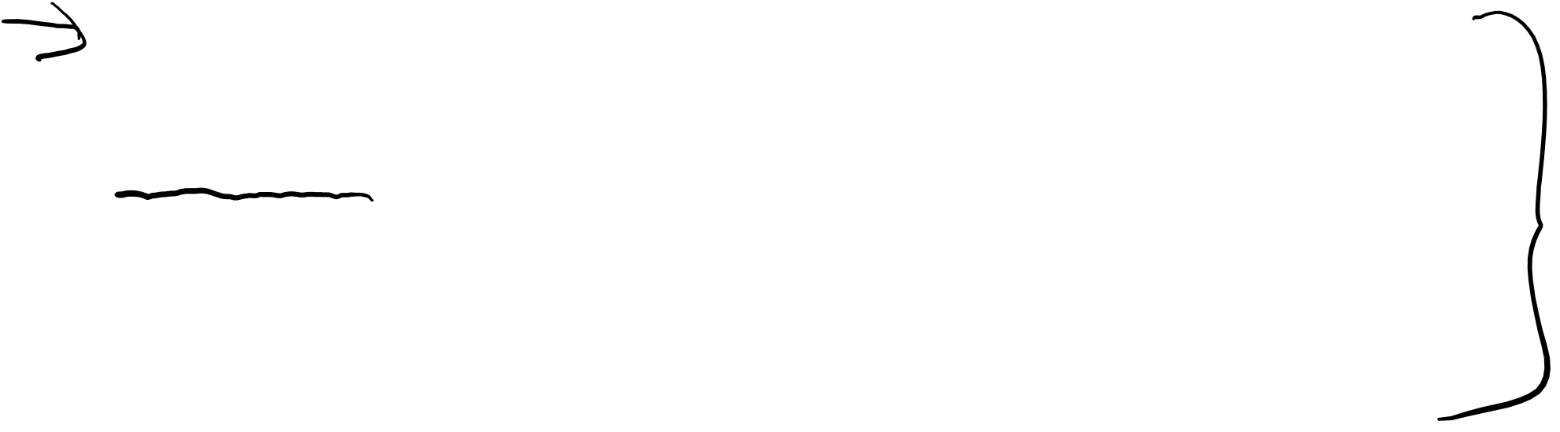
Dependency Inversion Principle (DIP) – Basic Idea
High-level Module
We want to be able to re-use these!
If high-level modules are independent of low-level modules, the high-level modules can be easily reused.
Low-level Module
We are fairly good at reusing these e.g. utilities, libraries, components, etc.

Slide 11

Dependency Inversion Principle (DIP) – Basic Idea
High-level Module
We want to be able to re-use these!
If high-level modules are independent of low-level modules, the high-level modules can be easily reused.
Low-level Module
We are fairly good at reusing these e.g. utilities, libraries, components, etc.
A. High-level modules should not depend on low-level modules. Both should depend on abstractions.
B. Abstractions should not depend upon details. Details should depend upon abstractions. (more on this later).

Slide 12
Two Layering Approaches Naïve and Inverted

Slide 13
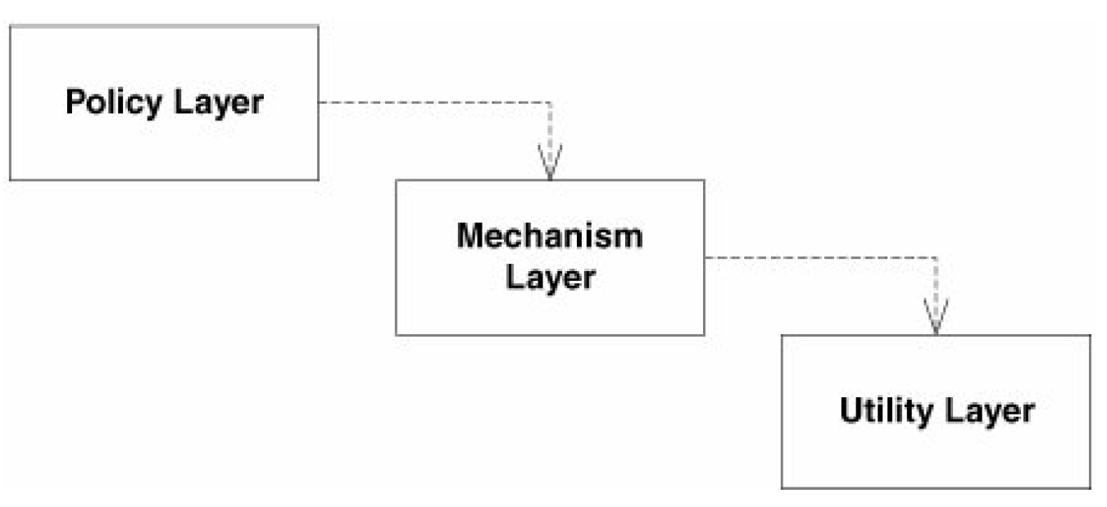
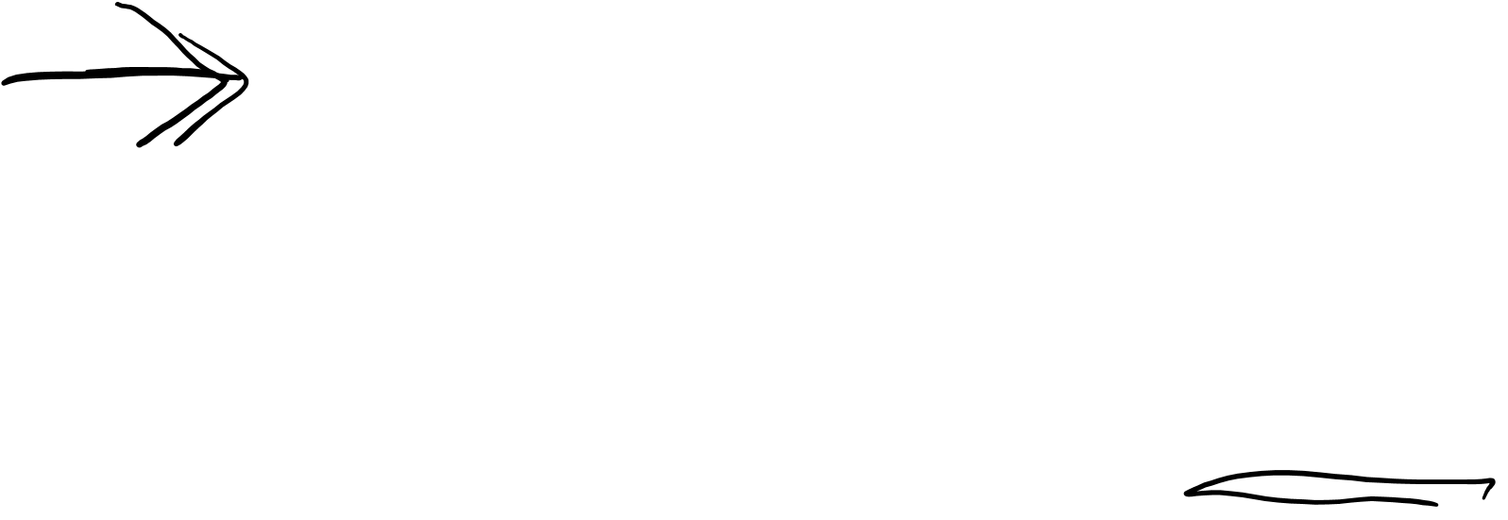
DIP – Naïve Layering
The high-level Policy layer uses a lower-level Mechanism layer, which in turn uses a Utility layer.
Problem: the Policy layer is sensitive to changes all the way down in the Utility layer.

Slide 14
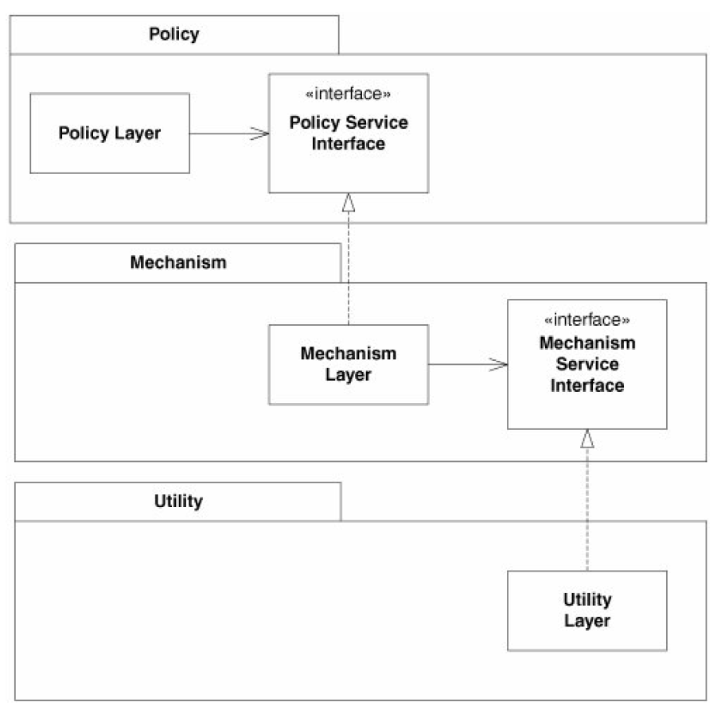
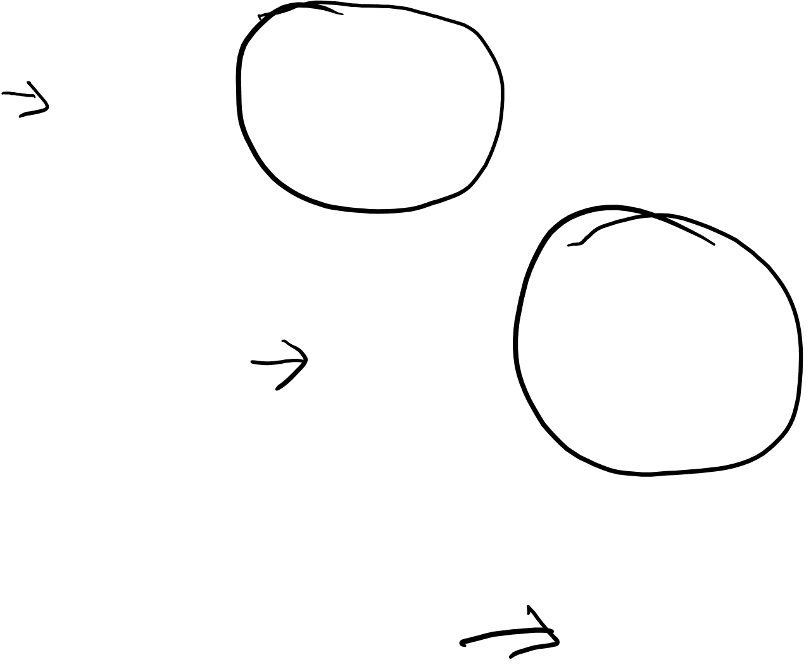
DIP – Inverted Layering (more appropriate!)
Each upper-level layer declares an abstract interface for the services it needs.

Slide 15
DIP – Inverted Layering (more appropriate!)
The lower-level layers are then realized from these abstract interfaces.
Each higher-level class uses the next lowest layer through the abstract interface.

Slide 16
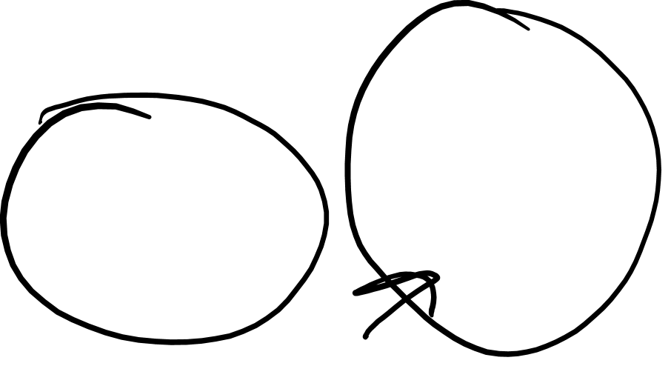
DIP – Inverted Layering (more appropriate!)
Now, the upper layers do not depend on the lower layers.
Instead, the lower layers depend on abstract service interfaces declared in the upper layers.

Slide 17

DIP – Inverted Layering (more appropriate!)
PolicyLayer can be reused in any context that defines lower-level modules
that conform to the PolicyService-Interface.
This is called Dependency Inversion.

Slide 18
Dependency inversion can be applied wherever one class sends a message to another.
Consider this simple example that violates DIP.

Slide 19
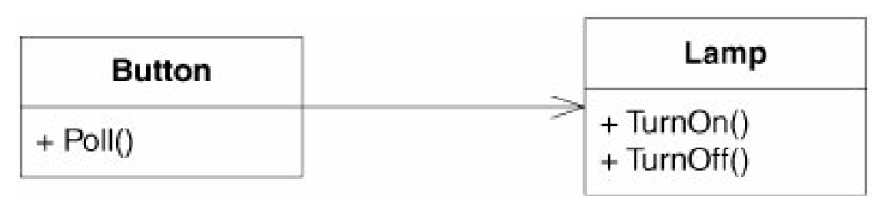
A Simple Example (that violates DIP)

Slide 20
A Simple Example (that violates DIP)
The Button object, receives a Poll message and determines whether the user has pressed the button.

Slide 21
A Simple Example (that violates DIP)
messages
The Button object, receives a Poll message and determines whether the user has pressed the button.
Button messages the lamp. On receiving a:
TurnOn message, the Lamp object turns on a light.
TurnOff message, it turns off that light.

Slide 22

A Simple Example (that violates DIP)
messages
public class Button
{
private Lamp lamp;
public void Poll()
{
if (/*some condition*/)
lamp.TurnOn();
}
}
Code Example:

Slide 23
A Simple Example (that violates DIP)
messages
Naïve Implementation!
The Button class depends directly on the Lamp class.

Slide 24
A Simple Example (that violates DIP)
messages
DEPENDENCY: This dependency implies that Button will be affected by changes to Lamp.
REUSE: Also, it will not be possible to reuse
Button to control, say, a Motor object. In this model, Button objects control Lamp
objects and only Lamp objects.

Slide 25
Let’s now invert this dependency on Lamp and see what happens!
messages

Slide 26
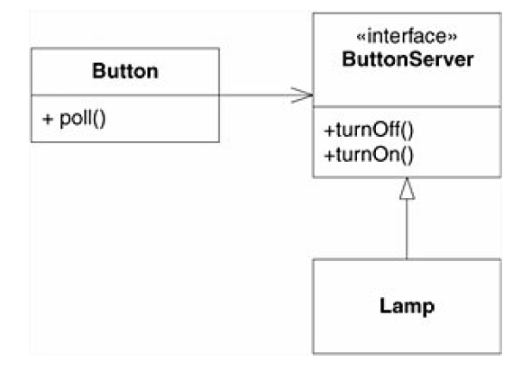
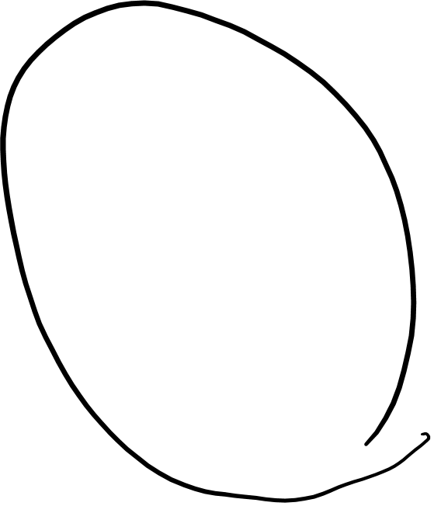
messages
becomes
messages
implements

Slide 27
Button now holds an association to something called a ButtonServer, which provides the interfaces that Button can use to turn something on or off.
Button can now control anything implementing ButtonServer → flexibility and reuse!
messages
implements

Slide 28
Button now holds an association to something called a ButtonServer, which provides the interfaces that Button can use to turn something on or off.
Button can now control anything implementing ButtonServer → flexibility and reuse!
messages
Lamp implements the
ButtonServer interface.
Lamp is now doing the depending rather than being depended on.
implements

Slide 29
A. High-level modules should not depend on low-level modules. Both should depend on abstractions.
B. Abstractions should not depend upon details. Details should depend upon abstractions.
messages
Dependency Inversion
Principle
(DIP)
implements

Slide 30
A. High-level modules should not depend on low-level modules. Both should depend on abstractions.
B. Abstractions should not depend upon details. Details should depend upon abstractions.
This approach is critically important for the construction of code that is resilient to change.
Since abstractions and details are isolated from each other, the code is much easier to maintain.
messages
implements

